Slide 1
Webpage Figure
부제목
2021. 09. 23
심철동

Slide 2
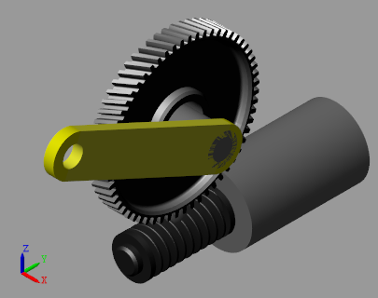
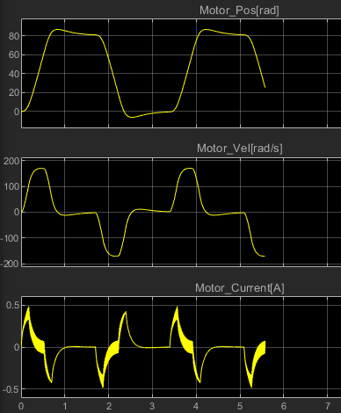
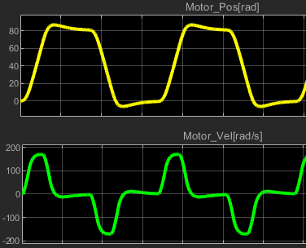
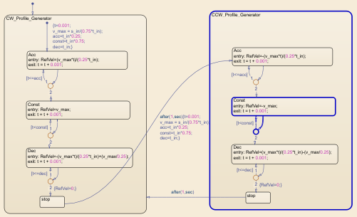
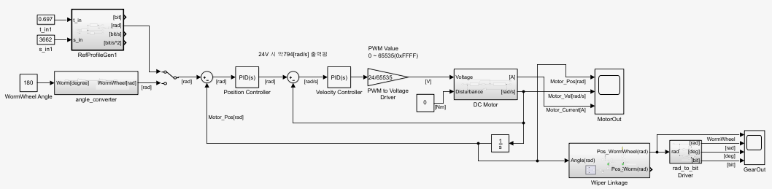
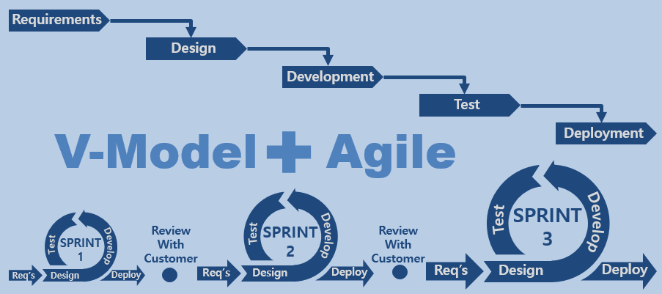
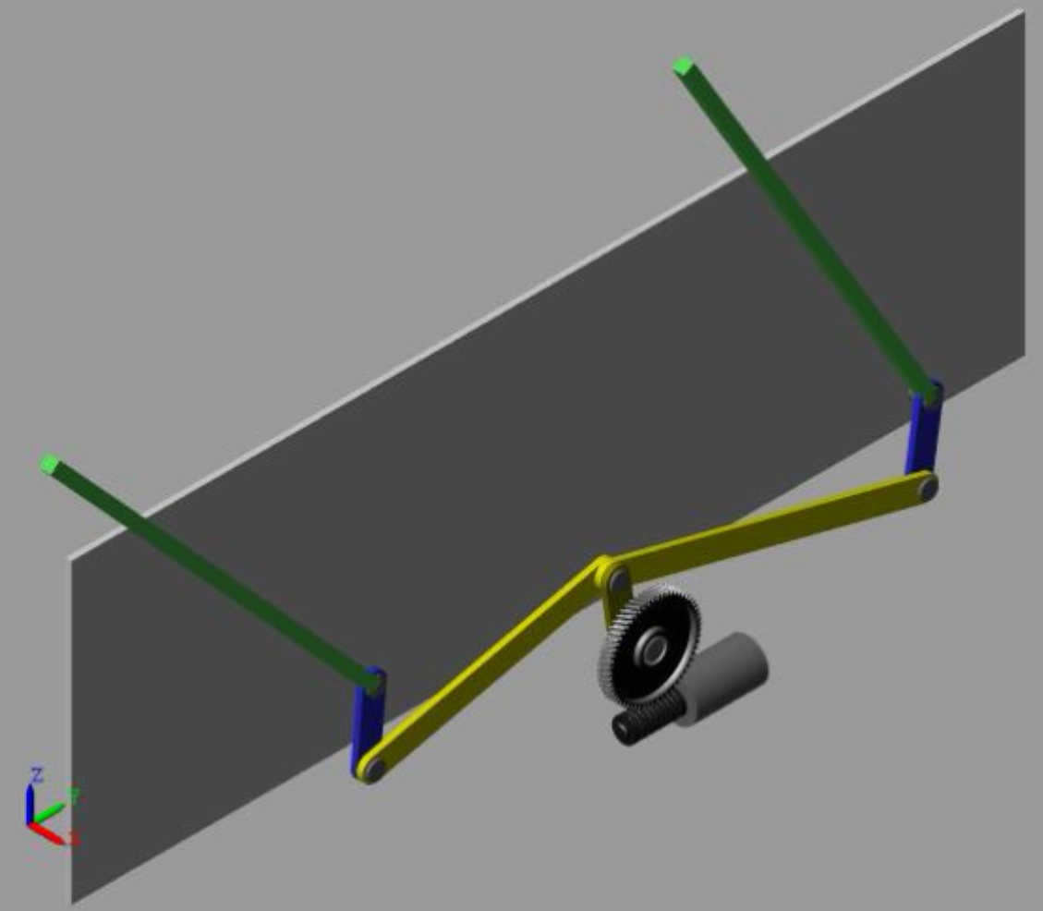
웹페이지 첫화면 이미지
Requirements
Design
Development
Test
V-Model
Agile
Deployment
SPRINT
3
Review
With
Customer
SPRINT
2
Review
With
Customer
Test
Develop
SPRINT
1
Test
Develop
Test
Develop
Req’s
Design
Deploy
Req’s
Design
Deploy
Req’s
Design
Deploy
Requirements
Design
Requirements
Development
Design
Test
Development
Agile with V-Model
Deployment
Test
V-Model
Agile
Deployment
SPRINT
3
Review
With
Customer
SPRINT
2
Review
With
Customer
Test
Develop
SPRINT
1
Test
Develop
SPRINT
3
Test
Develop
Review
With
Customer
SPRINT
2
Review
With
Customer
Test
Develop
Req’s
Design
Deploy
Req’s
Design
Deploy
Req’s
Design
Deploy
SPRINT
1
Test
Develop
Test
Develop
Req’s
Design
Deploy
Req’s
Design
Deploy
Req’s
Design
Deploy

Slide 3
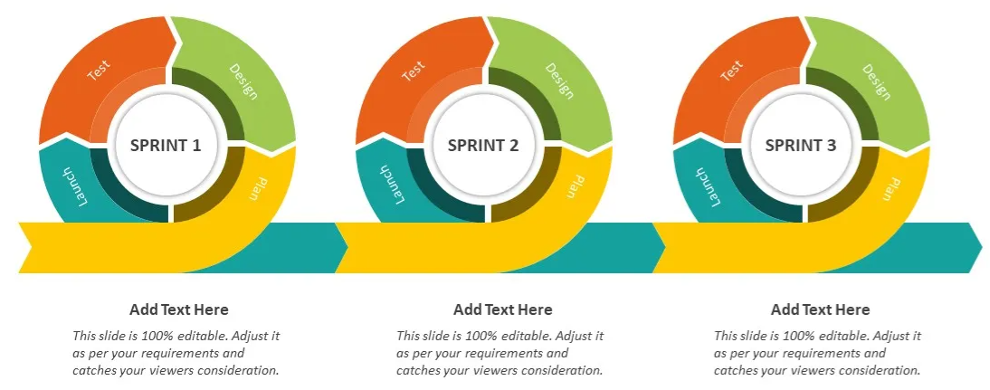
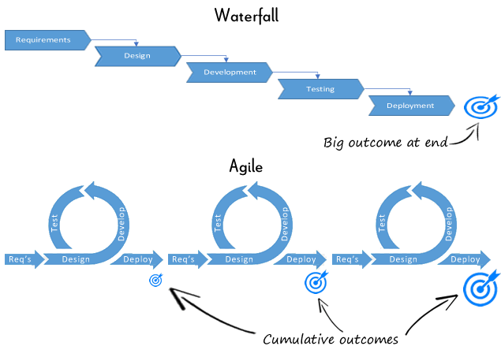
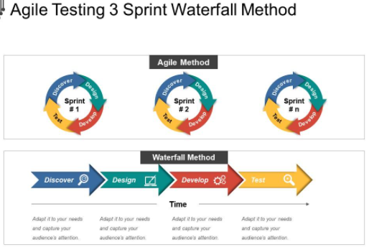
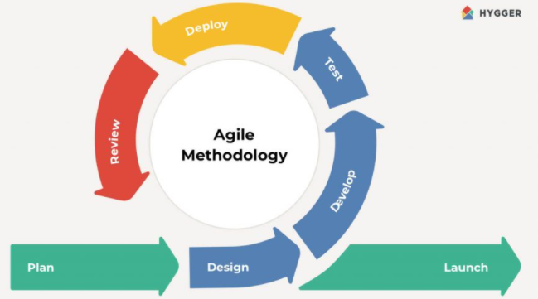
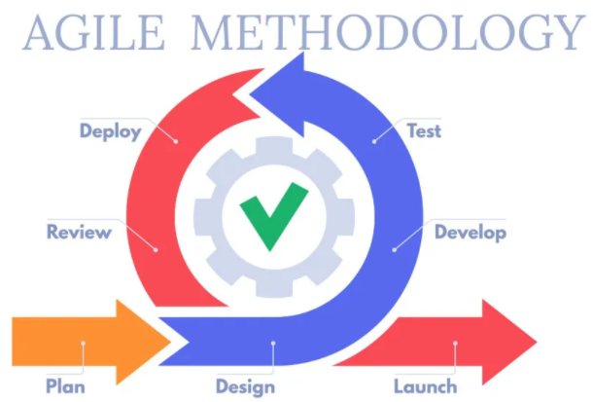
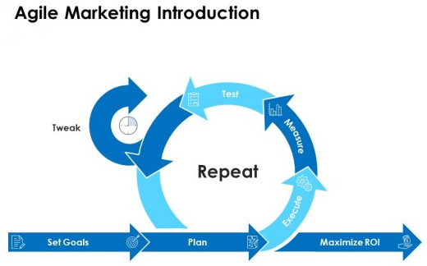

Slide 4
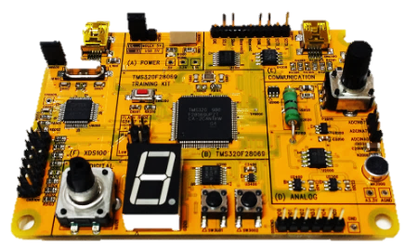
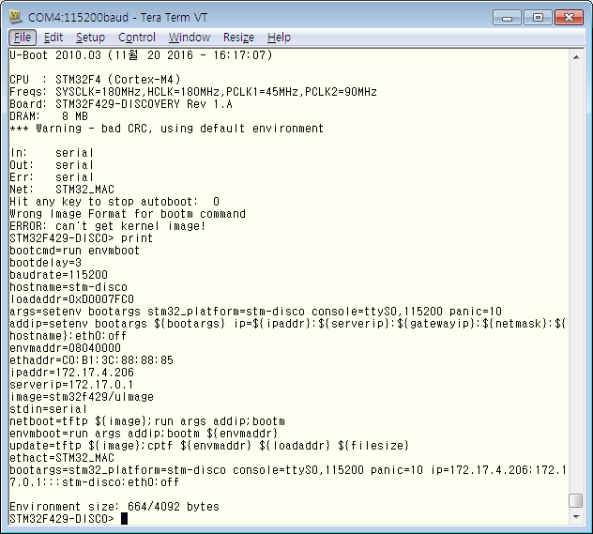
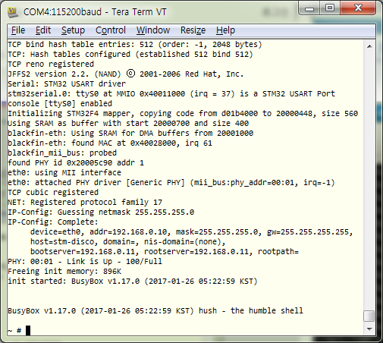
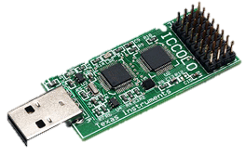
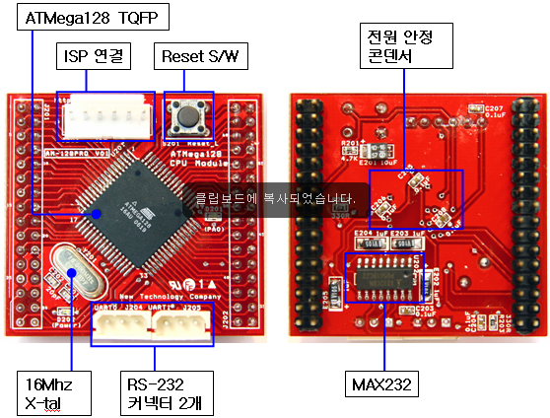
웹페이지 첫화면 이미지
Requirements
Design
Development
Test
V-Model
Agile
Deployment
SPRINT
3
Review
With
Customer
SPRINT
2
Review
With
Customer
Test
Develop
SPRINT
1
Test
Develop
Test
Develop
Req’s
Design
Deploy
Req’s
Design
Deploy
Req’s
Design
Deploy
u-boot 부트로더 확인
linux kernel 확인

Slide 5
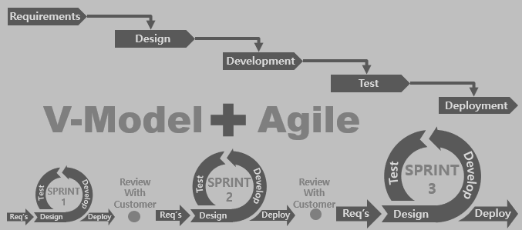
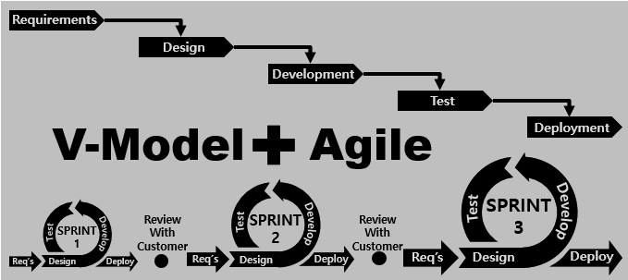
웹페이지 첫화면 이미지
Requirements
Requirements
Requirements
Requirements
Design
Design
Design
Design
Development
Development
Development
Development
Test
Test
Test
Test
V-Model
V-Model
Agile
Agile
V-Model
V-Model
Agile
Deployment
Agile
Deployment
Deployment
Deployment
SPRINT
3
SPRINT
3
SPRINT
3
Test
SPRINT
3
Test
Test
Develop
Test
Develop
Develop
SPRINT
2
Develop
SPRINT
2
SPRINT
2
Review
With
Customer
SPRINT
2
Review
With
Customer
Review
With
Customer
Review
With
Customer
Review
With
Customer
Review
With
Customer
Review
With
Customer
Test
Review
With
Customer
Test
Test
Develop
Test
Develop
Develop
SPRINT
1
Develop
SPRINT
1
SPRINT
1
Test
SPRINT
1
Test
Test
Develop
Test
Develop
Develop
Deploy
Develop
Deploy
Deploy
Req’s
Deploy
Req’s
Req’s
Design
Req’s
Design
Design
Deploy
Design
Deploy
Deploy
Req’s
Deploy
Req’s
Req’s
Design
Req’s
Design
Design
Deploy
Design
Deploy
Deploy
Req’s
Deploy
Req’s
Req’s
Design
Req’s
Design
Design
Design

Slide 6
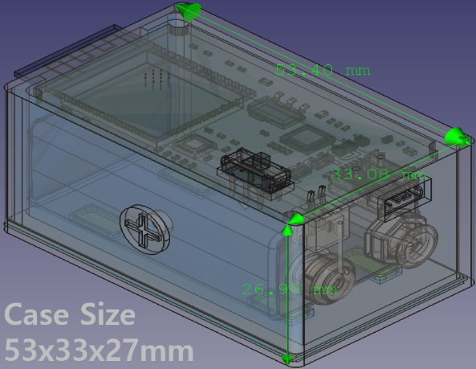
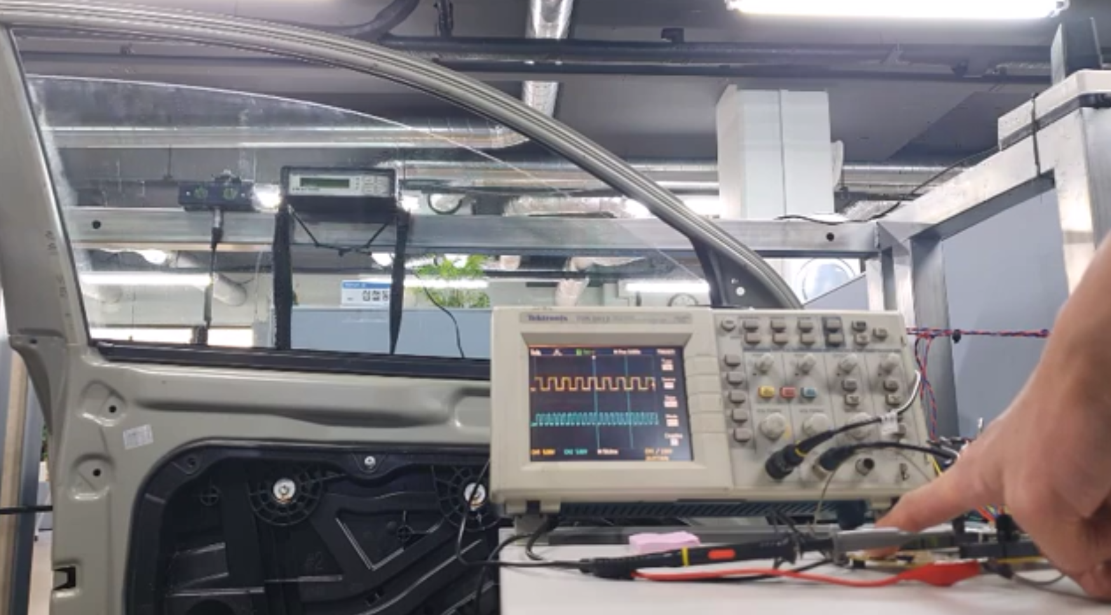
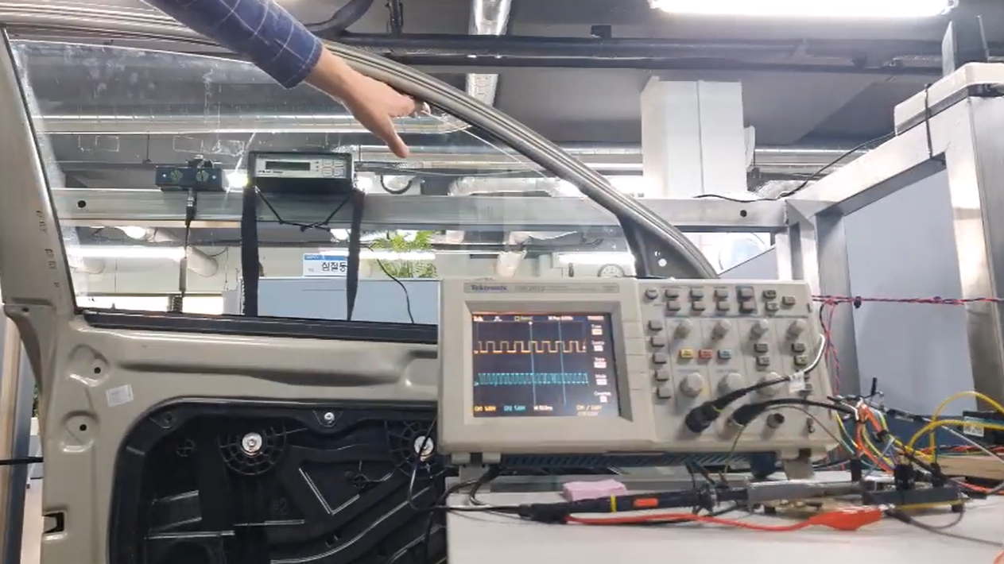
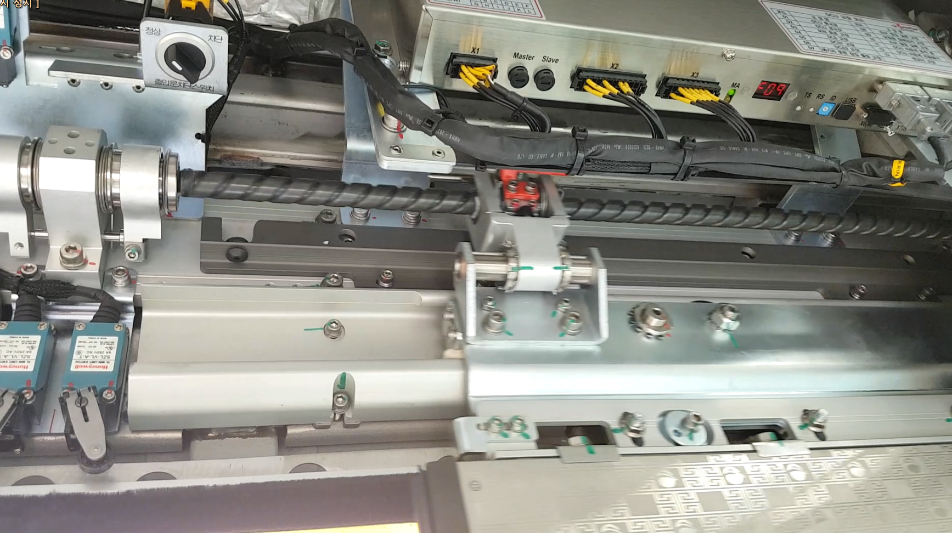
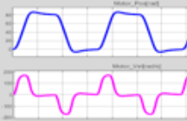
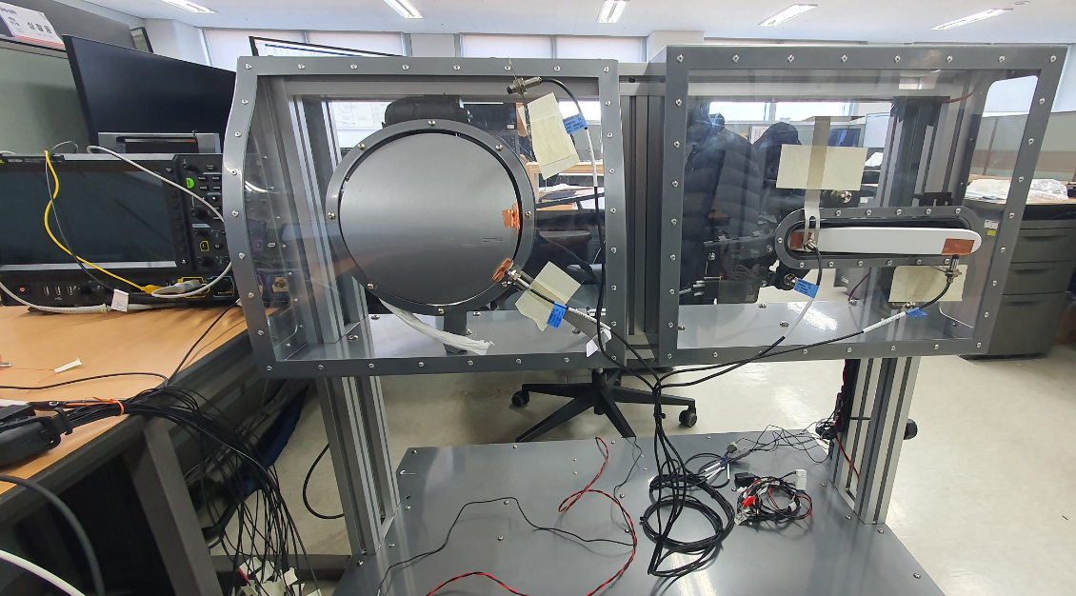
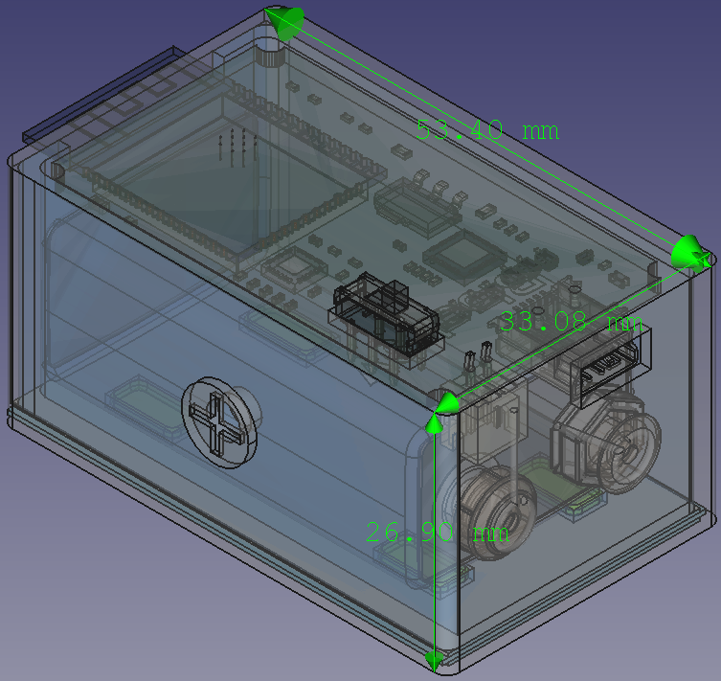
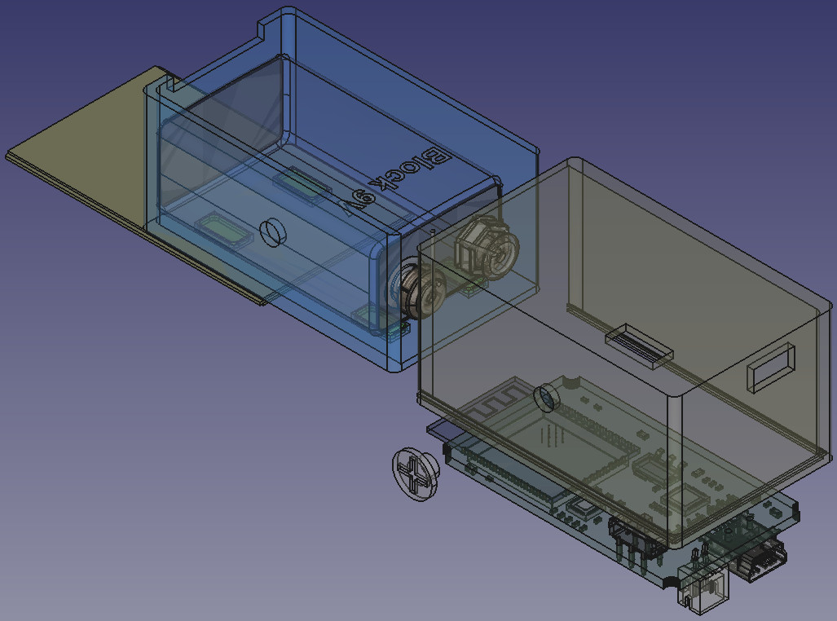
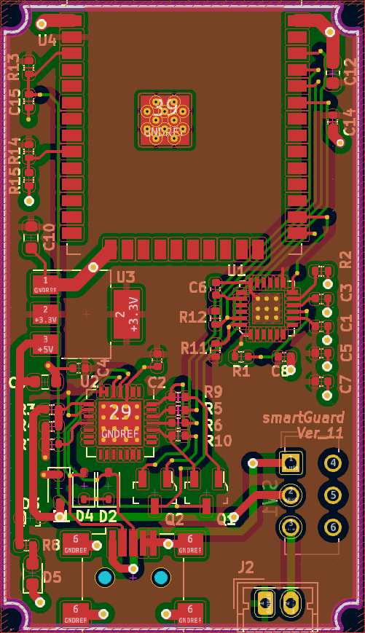
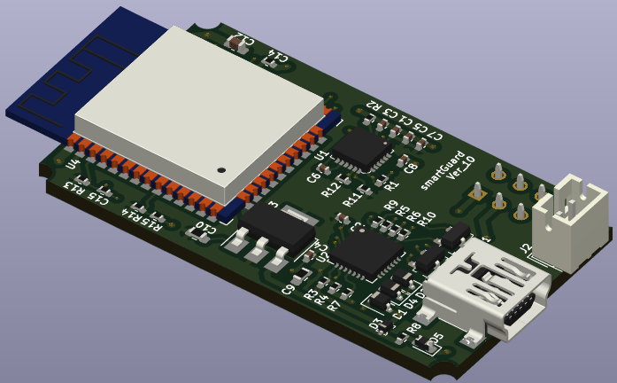
Case
53x33x27mm

Slide 7
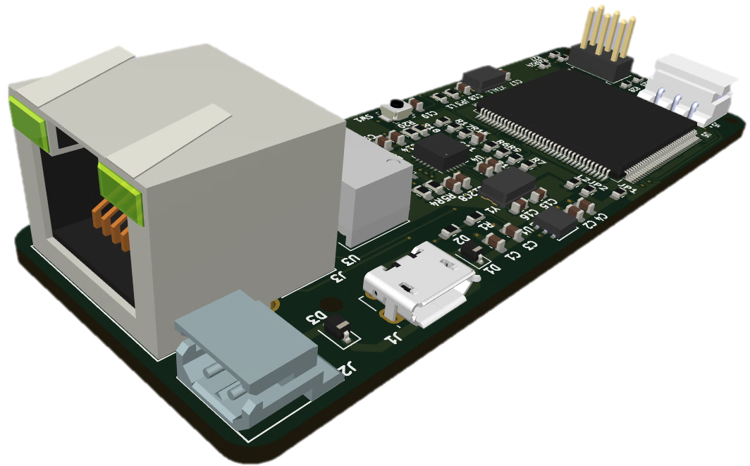
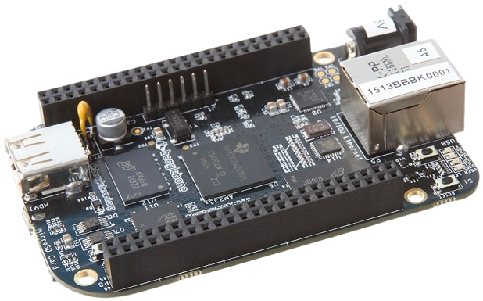
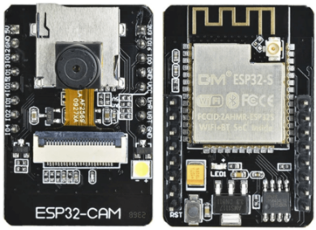

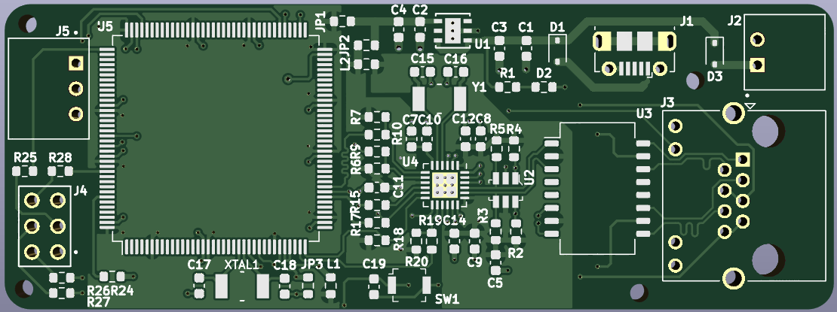

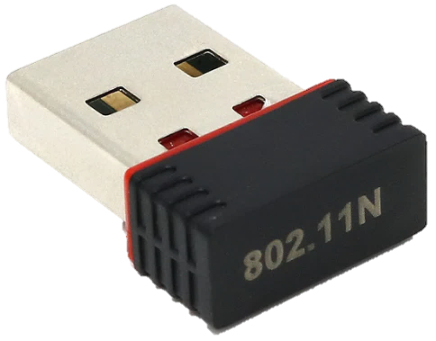
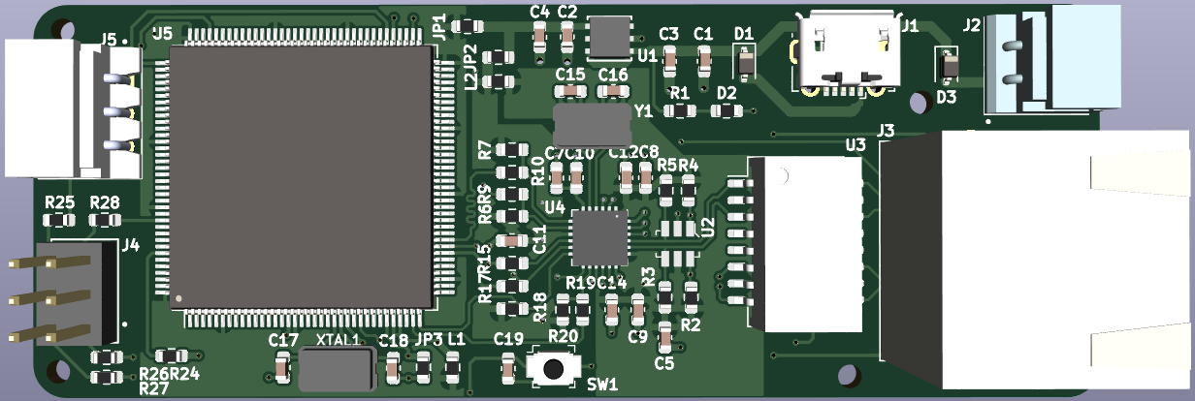



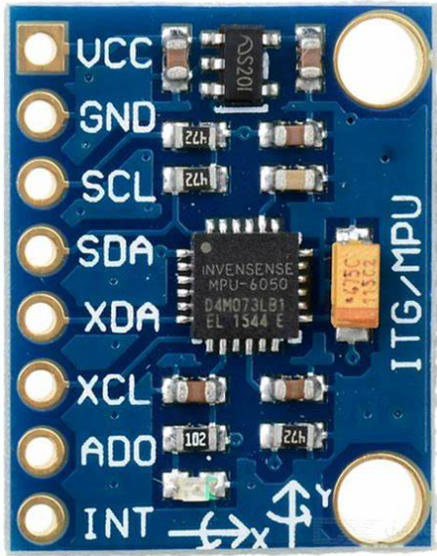
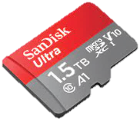
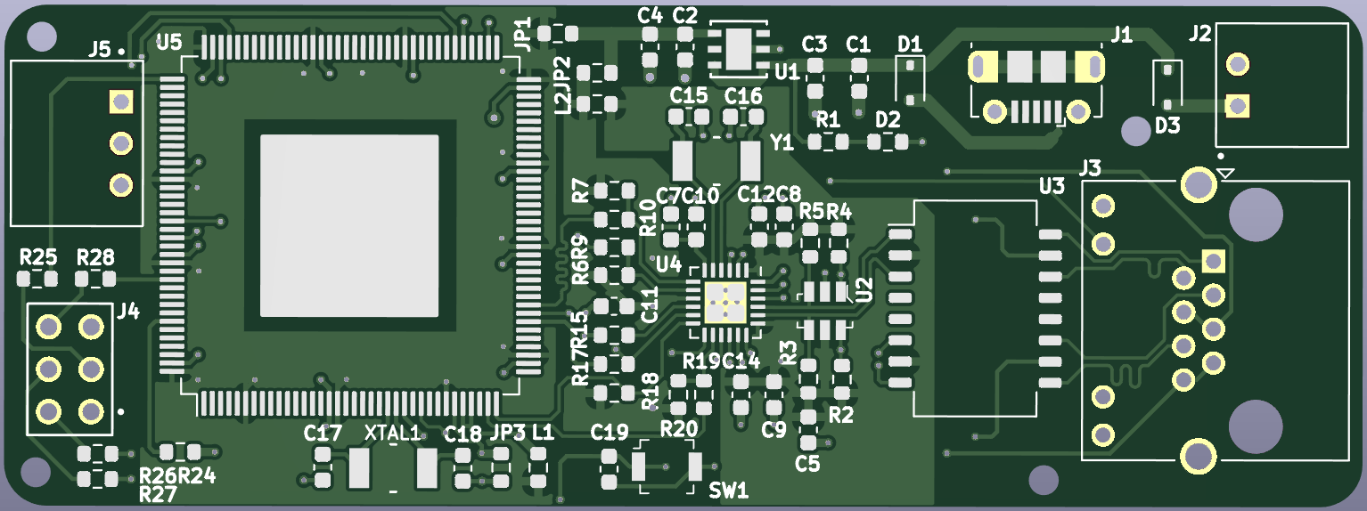



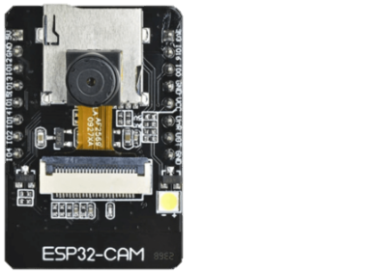

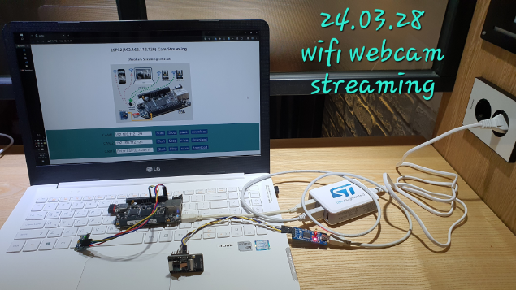
BBB
HTTP Stream
ESP32-CAM
ESP32-CAM
usb-wifi
adapter
IMU Sensor
ESP32-CAM
ESP32-CAM
ESP32-CAM
ESP32-CAM
HTTP Stream
HTTP Stream
usb-wifi
adapter
IMU Sensor
usb-wifi
adapter
IMU Sensor
BBB
BBB

Slide 8
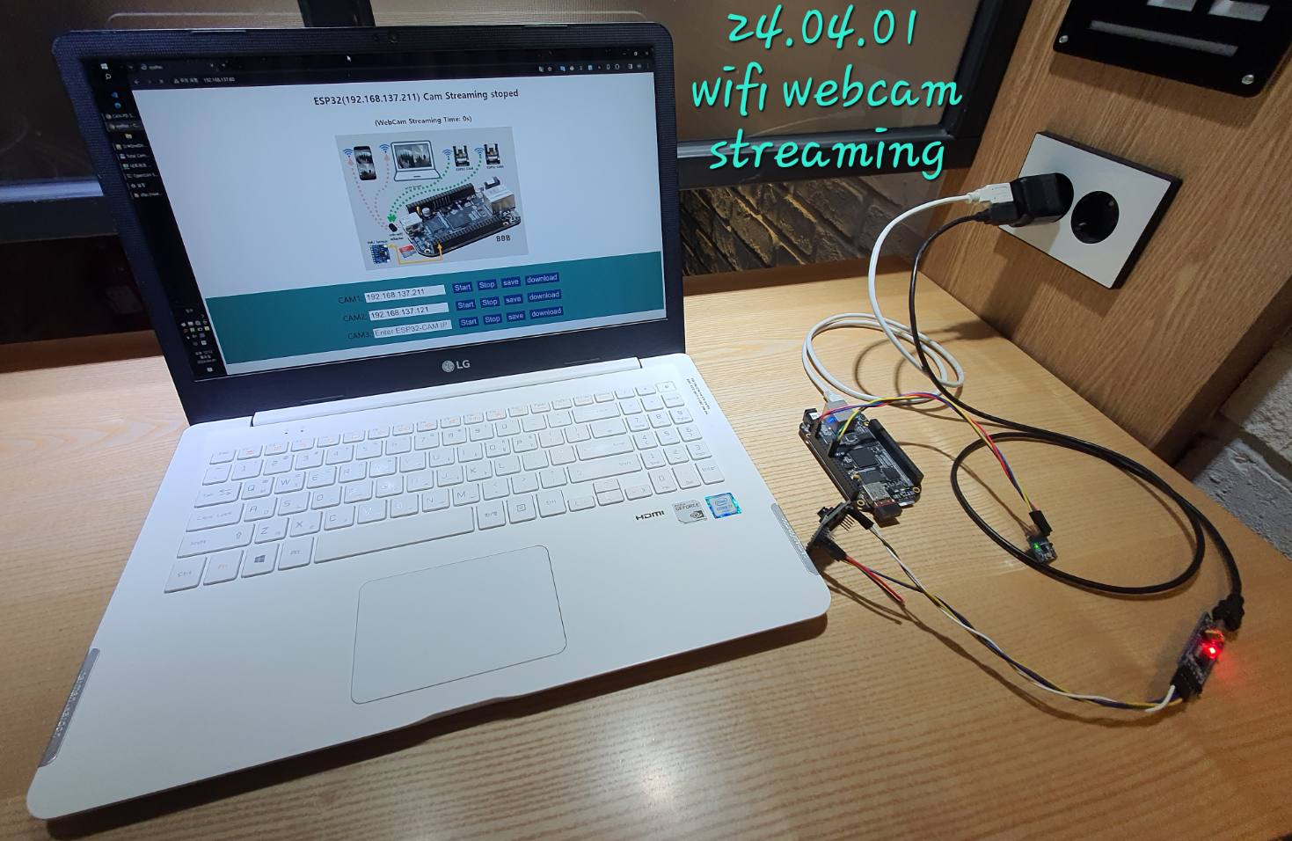
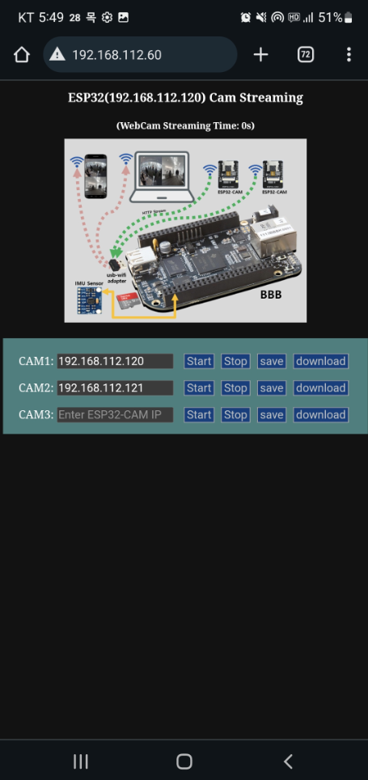
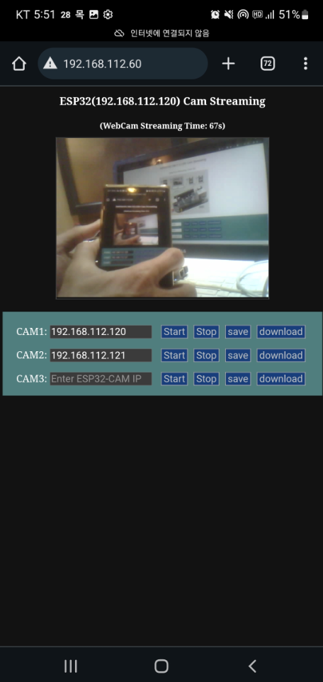
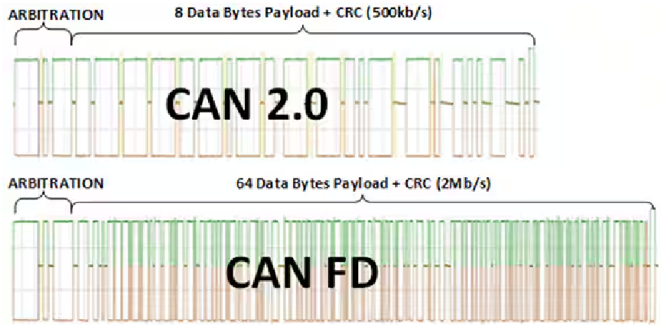
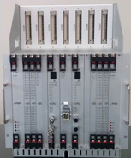
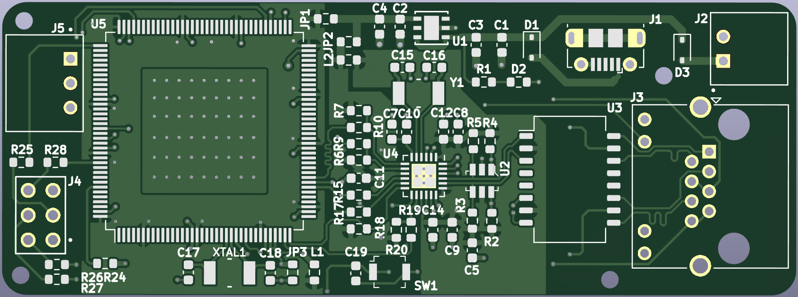
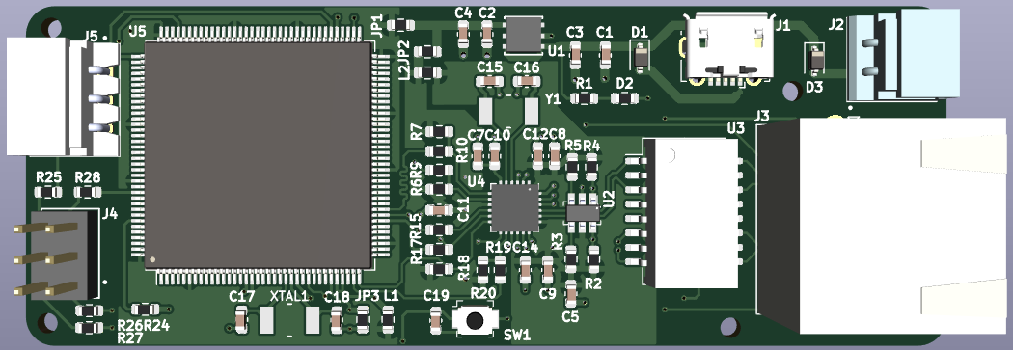
업데이트중
wifi Access
on SmartPhone
업데이트중
TCMS
업데이트중

